Slide 1
Prova Finale:
Progetto di Ingegneria del Software
Andrea Piras - 936909 Andrea Sanguineti - 936930 Emanuele Santoro - 933198
05/07/2022

Slide 2
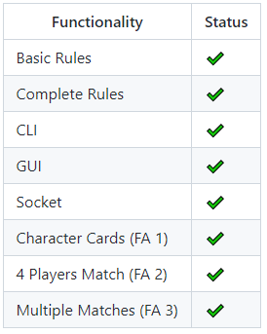
Implemented Functionalities
Character Cards
Divided logic and data of cards
Data is loaded from a JSON file
4 Players Match
Implemented through Team class
Multiple Matches
Implemented through a map of Controllers handled by the Server class
Extra improvements to QOL
Chat between players in the same game
PingPong messages to detect disconnections in function of connection delays
Delta updates

Slide 3
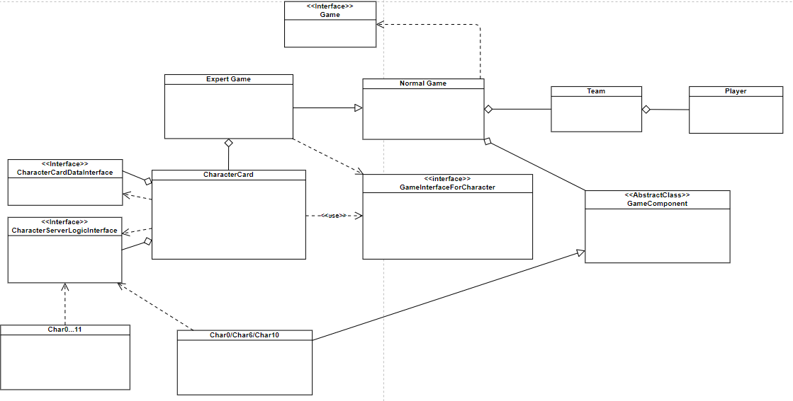
Model

Slide 4
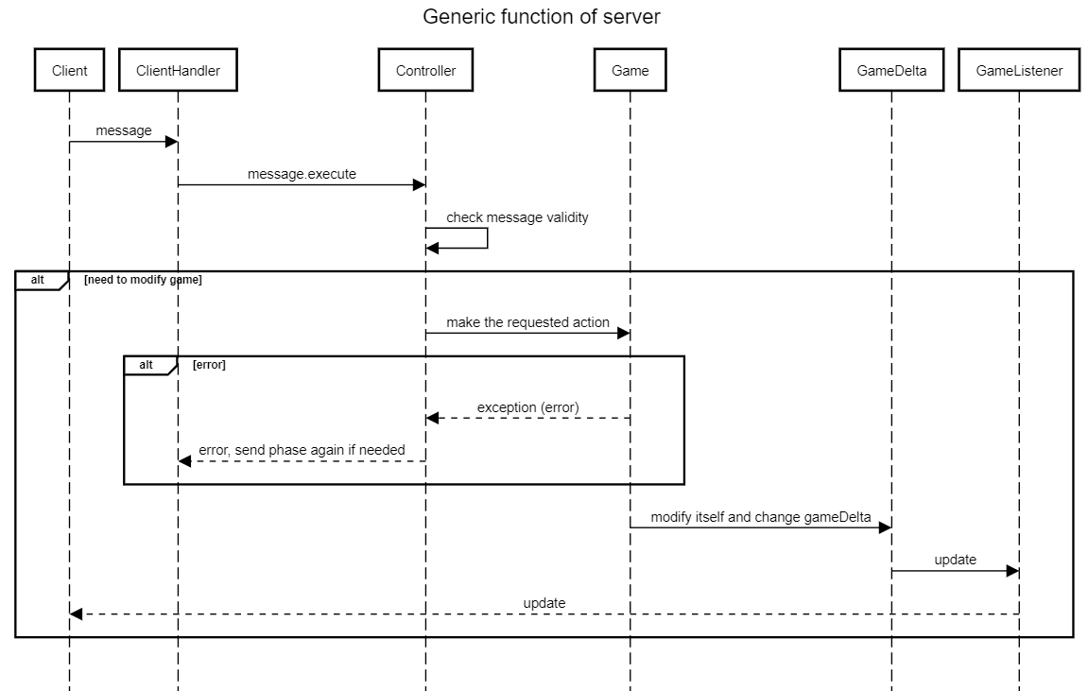
Server

Slide 5
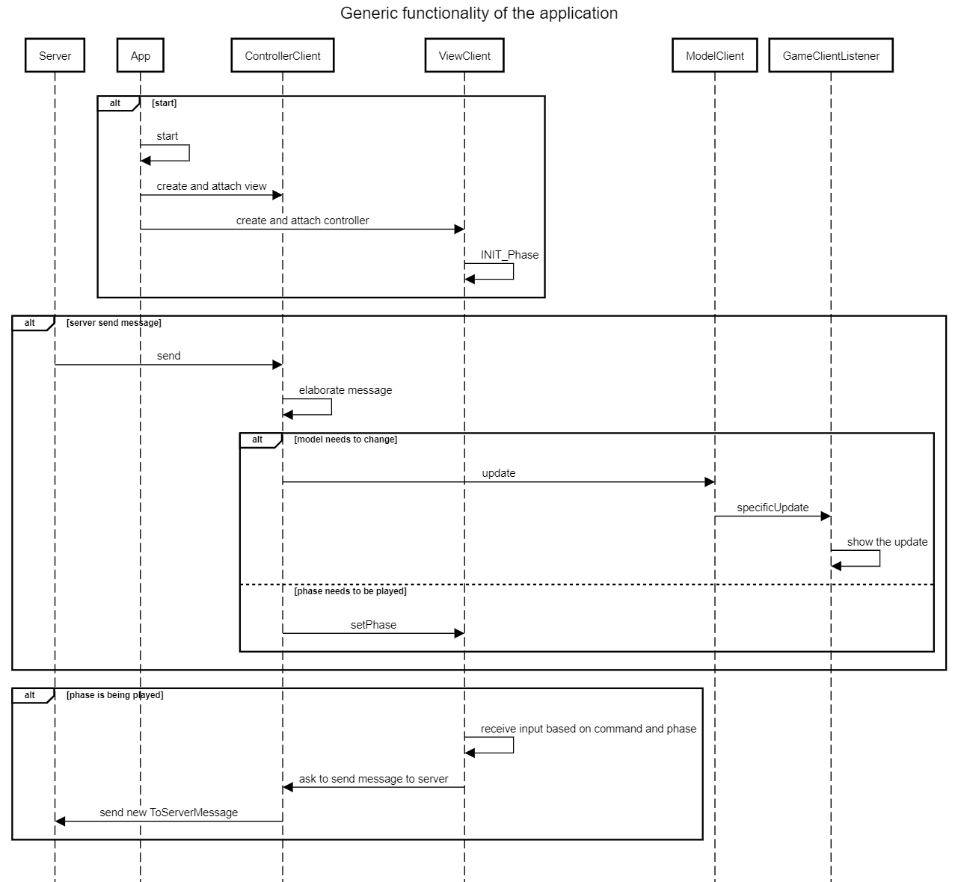
Client

